Slide 1
The Medical Reserve Corps (MRC)
Name of Presenter
Organization
Date

Slide 2
What is the MRC?
The Medical Reserve Corps (MRC) is a national network of volunteers, organized locally to improve the health and safety of their communities
The MRC started as a demonstration project by the U.S. Department of Health and Human Services (HHS) in 2002 after the events of September 11 identified a need to organize and train medical volunteers to assist in emergencies
In 2006, Congress passed the Pandemic and All-Hazards Preparedness Act, which formally established the Medical Reserve Corps “to provide for an adequate supply of volunteers in the case of a Federal, State, local, or tribal public health emergency”
Today, the MRC network comprises approximately 200,000 volunteers
in roughly 800 community-based units across the U.S. and its territories

Slide 3
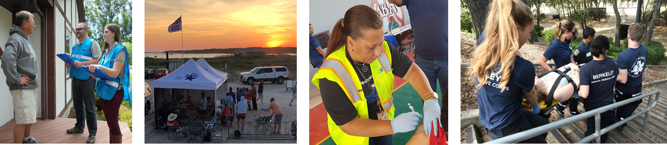
What does the MRC do?
MRC units engage in their local communities to improve emergency response capabilities, build community preparedness and resilience, and strengthen public health
No MRC unit is the same – specific engagement activities vary by community need, volunteer skills and interest, and partner support

Slide 4
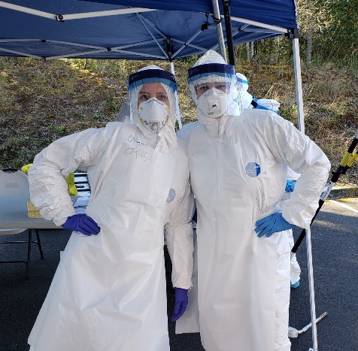
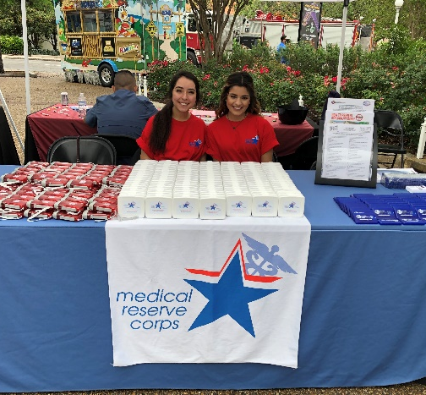
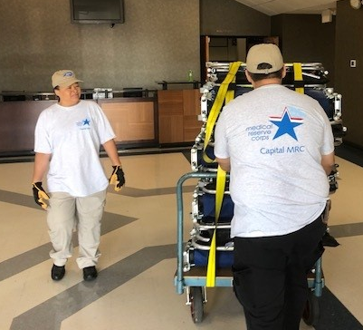
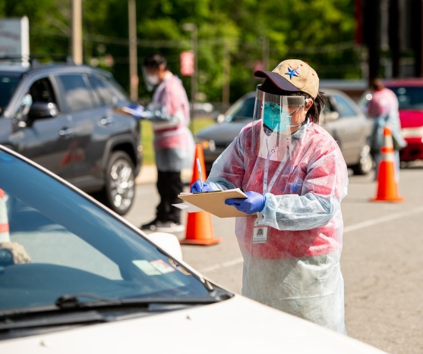
How do MRC units benefit the community?
Bolster local public health and emergency response infrastructures by providing supplemental personnel
Enable communities to meet specific health needs
Give community members the opportunity to offer their skills and time to make their communities healthier and safer

Slide 5
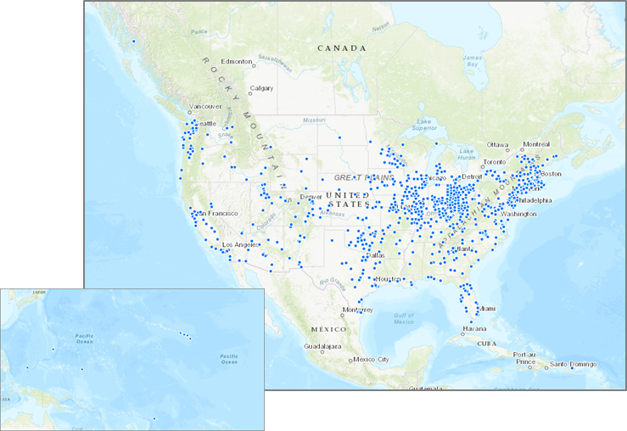
Where are MRC units located?
There are roughly 800 MRC units located across the U.S. and its territories, including:
  48 states
  American Samoa, Federated
  States of Micronesia,
  Palau, Puerto Rico, and
  Northern Mariana Islands
Size of MRC units ranges
from fewer than 50 to
more than 2,500 volunteers

Slide 6
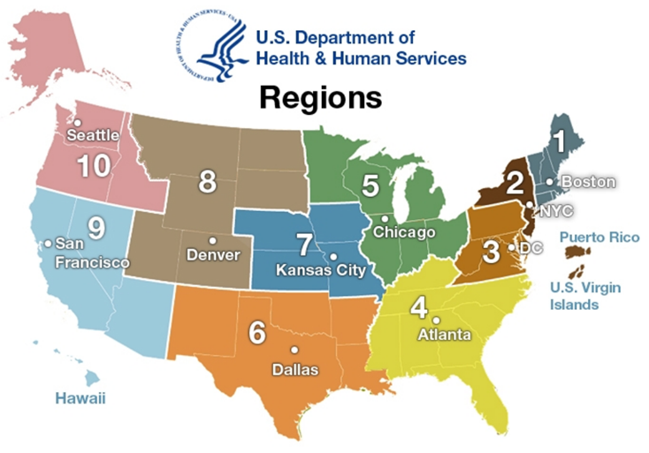
Number of MRC Units by Region
Data as of February 2021

Slide 7
Types of MRC Volunteers
Data as of February 2021

Slide 8


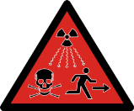


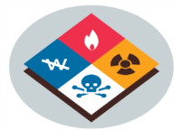

At a Glance: MRCs in the Community
In the most recent MRC Network Profile, below are the types of emergency responses MRC units participated in.
Natural Disasters
68%
Infectious
Disease Outbreaks
28%
Human Induced / Civil Hazards
12%
Technological
Hazards
4%
Foodborne Illness
3%
Hazardous Materials Spills
3%
Other
Emergencies
17%
Source: 2017 MRC Network Profile

Slide 9
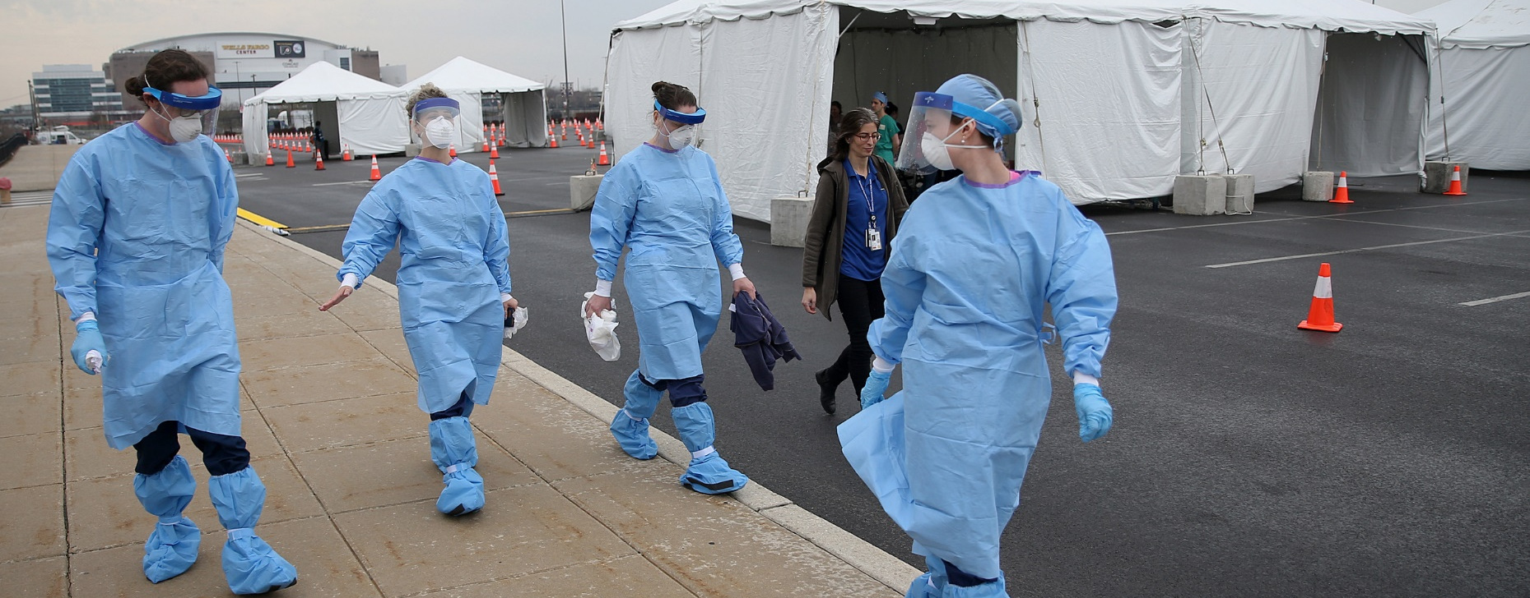

At a Glance: COVID-19 Response
Common MRC Missions
  Testing
  Epidemiology and Surveillance
  Medical Surge
  Community Screening
  Call Center Operations
  Behavioral Health
  Community Education
  Community Outreach
  Logistics
  Training
  Mass Vaccination
800,000+ volunteer
hours dedicated
to COVID-19
response in 2020

Slide 10
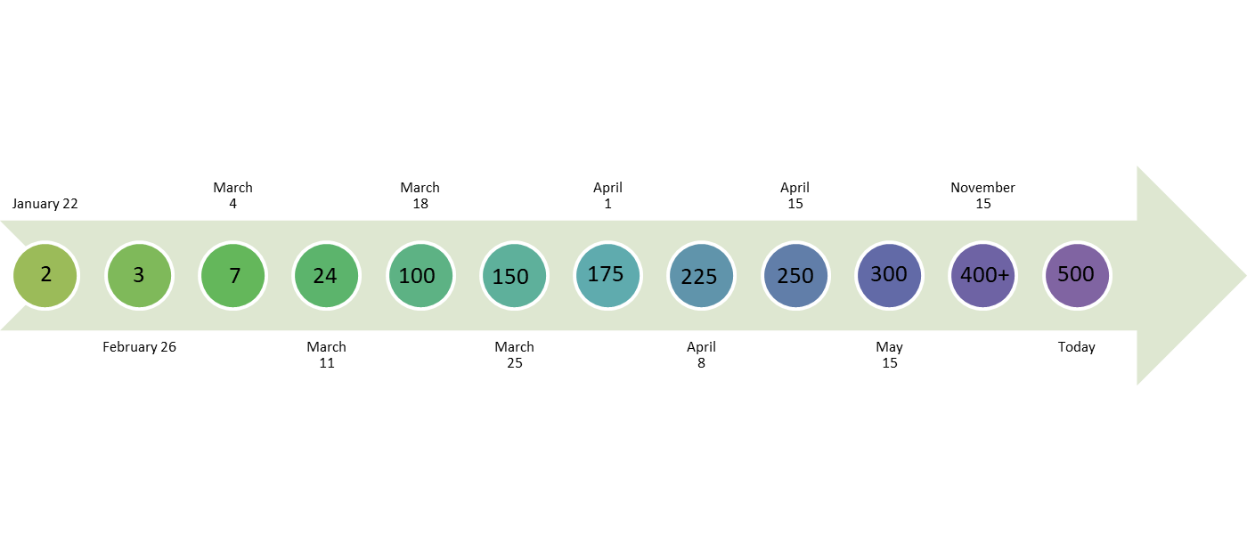
At a Glance: COVID-19 Response (cont’d)
Number of MRC units activated
Data as reported to the MRC Program Office
Includes MRC units in 48 states, the District of Columbia, Puerto Rico, American Samoa, and the Northern Mariana Islands
Data as of February 2021

Slide 11
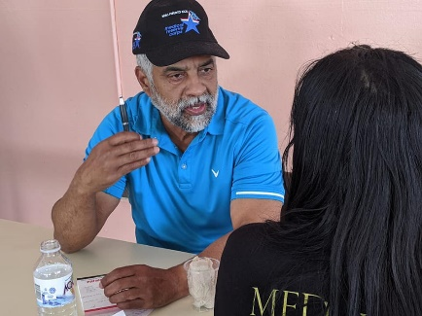
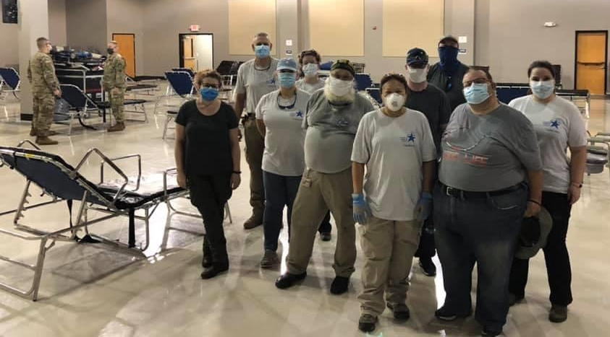
At a Glance: 2020 Responses
After an earthquake struck Southwest Puerto Rico, the MRC of Puerto Rico (PR) conducted shelter support, medical assessments, and community needs assessments of impacted populations
In response to Hurricane Isaias, members of the Capital MRC (NC) set up a medical shelter for displaced nursing home and home health patients. In addition, the New Castle County MRC (DE) and Western Tidewater MRC (VA) supported shelters and Delaware County MRC (PA) assisted with an evacuation/reception center. MidCarolina SMAT (NC) also deployed its medical shelter support trailer to assist local response efforts
After a derecho passed through Iowa and caused widespread power outages, volunteers with the Johnson County MRC (IA) made wellness check calls and in-person wellness checks on local community members with special medical needs. Grundy County MRC (IA) volunteers helped with recovery and clean-up after the storm
MRC of Puerto Rico (PR) supports earthquake response efforts
Capital MRC (NC) sets up a shelter in anticipation of Hurricane Isaias

Slide 12
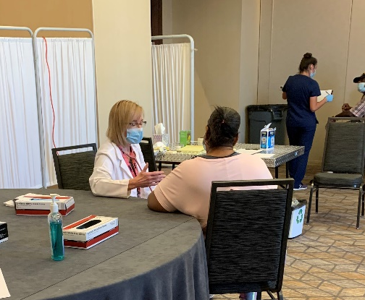
At a Glance: 2020 Responses (cont.)
MRC units in Louisiana, Texas, Alabama, and Hawaii responded to a series of hurricanes and tropical storms. Volunteers provided evacuation support, sheltering support, triage/first aid, medical needs tracking, and medical assessments, including COVID-19 screenings for evacuees
Several MRC units in Arizona, California, Colorado, Nebraska, Oregon, Utah, and Washington State responded to wildfires and grassland fires. Volunteers provided evacuation and clean air shelter support, veterinary medical support, medical supply management, and responder rehab
MRC units administered vaccinations in response to Hepatitis A outbreaks in communities across the country
Several MRC units responded to winter weather events in early 2020, assisting at shelters and warming centers
Alamo Area MRC (TX) volunteers respond to Hurricane Laura, providing medical assessments and COVID-19 screenings for evacuees

Slide 13

MRC Program Communications
Visit the MRC website at https://mrc.hhs.gov
Join the MRC Program Office’s One-way or Two-way
Listservs: https://mrc.hhs.gov/pageViewFldr/MRCListservs
Join MRC-TRAIN: https://www.train.org/mrc/
Like us on Facebook:
https://www.facebook.com/medicalreservecorps
Follow us on Twitter: @MRC_ASPR or
visit https://www.twitter.com/MRC_ASPR
To find an MRC unit near you, visit http://mrc.hhs.gov/FindMRC

